Slide 1
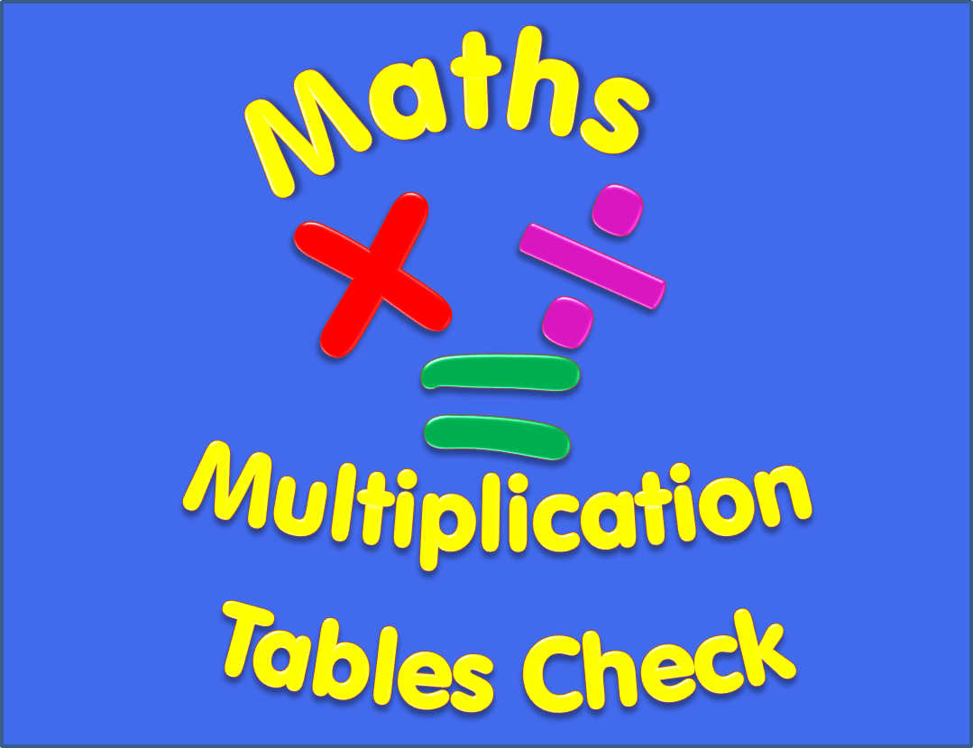

Slide 2
Begin
Instructions
There are 25 multiplication questions on any times table from 2 to 12.
Each multiplication question will appear on the screen for 6 seconds. There will then be a 3 second break before the next question appears.
Good Luck!

Slide 3
6 x 6
Q1

Slide 4
7 x 10
Q2

Slide 5
8 x 11
Q3

Slide 6
9 x 9
Q4

Slide 7
12 x 8
Q5

Slide 8
8 x 5
Q6

Slide 9
7 x 8
Q7

Slide 10
12 x 5
Q8

Slide 11
11 x 3
Q9

Slide 12
2 x 5
Q10

Slide 13
6 x 2
Q11

Slide 14
7 x 7
Q12

Slide 15
8 x 9
Q13

Slide 16
9 x 4
Q14

Slide 17
6 x 12
Q15

Slide 18
6 x 9
Q16

Slide 19
4 x 7
Q17

Slide 20
9 x 5
Q18

Slide 21
8 x 3
Q19

Slide 22
12 x 12
Q20

Slide 23
3 x 4
Q21

Slide 24
3 x 6
Q22

Slide 25
5 x 8
Q23

Slide 26
10 x 11
Q24

Slide 27
7 x 9
Q25

Slide 28
Completed!
All multiplication questions have now been shown.
To find out your score click on the button below.
Answers

Slide 29
Answers
1) 6 x 6 = 36 2) 7 x 10 = 70 3) 8 x 11 = 88
4) 9 x 9 = 81 5) 12 x 8 = 96 6) 8 x 5 = 40
7) 7 x 8 = 56 8) 12 x 5 = 60 9) 11 x 3 = 33
10) 2 x 5 = 10 11) 6 x 2 = 12 12) 7 x 7 = 49
13) 8 x 9 = 72 14) 9 x 4 = 36 15) 6 x 12 = 72
16) 6 x 9 = 54 17) 4 x 7 = 28 18) 9 x 5 = 45
19) 8 x 3 = 24 20) 12 x 12 = 144 21) 3 x 4 = 12
22) 3 x 6 = 18 23) 5 x 8 = 40 24) 10 x 11 = 110
25) 7 x 9 = 63

